Slide 1
Writing a TEEL paragraph
Year 7 - Text response essay

Slide 2
Learning Outcomes
Why are we learning this?
How will I know when I’ve succeeded?
To improve your writing skills
To understand how to write a TEEL paragraph
You’ll be able to describe what a TEEL paragraph is
You will have turned your essay planning into your first finished paragraph

Slide 3

TEEL PARAGRAPHS
Text response essays

Slide 4

TEEL paragraphs
When writing essays, we can use a type of paragraph called a TEEL paragraph.
This allows us to present an idea clearly, logically and using evidence.
TEEL is not just used in English, but in many other subjects as well.

Slide 5
TEEL paragraphs
TEEL stands for:
Topic Sentence
Explanation
Evidence (or “example”)
Linking sentence

Slide 6
TEEL paragraphs
Remember that paragraphs always focus on one key idea.
The topic sentence introduces the idea.
The explanation expands on the idea in context.
Evidence is used to provide an example of the idea.
The linking sentence analyses how these things help to prove your overall contention.

Slide 7
The Topic Sentence
TEEL paragraphs

Slide 8
Topic Sentences
Remember what you learnt last lesson:
Topic sentence – the first sentence in an essay paragraph.
The topic sentence should be a short, clear sentence. It should clearly state the idea that will be discussed in the rest of the paragraph.
The subject in a topic sentence can be:
An idea (refugees in Australia, hope, family)
A character
The book (either the title, the author or a chapter)

Slide 9
Topic Sentences
You can build further on your topic sentence:
Start with a linking word,
Nominalise the sentence

Slide 10
Topic Sentences
Start with a linking word.
You can use prepositions to help sequence the ideas in each paragraph:
Initially,
From the outset,
At the beginning of the novel,
During Subhi’s time at the camp,
After the protest,
By the end of the text,

Slide 11
Topic Sentences
Practice your nominalisation
Start with a topic sentence about an idea:
The living conditions are depicted through
The lack of freedom is
Hope is explored when
Imagination is highlighted in

Slide 12
Topic Sentences
Practice your nominalisation
Try being even more specific:
The living conditions in the camp are depicted through
The lack of freedom felt by those in detention is
Feelings of hope are explored when
The importance of imagination is highlighted in

Slide 13
Topic Sentences
Practice your nominalisation
Try adding an adjective (describing word):
The harsh living conditions in the camp are depicted through
The ongoing lack of freedom felt by those in detention is
Fragile feelings of hope are explored when
The deep importance of imagination is highlighted in

Slide 14
Your Turn
Look at your first topic sentence.
(You should have already written this last week)
See if you can improve it by:
Starting with a linking word,
Nominalising the sentence.
Write out your finished topic sentence in your exercise book.

Slide 15
Explanation
TEEL Paragraphs

Slide 16
Explanations
After your topic sentence, you need to begin expanding on the idea.
Explain how the idea is demonstrated through specific characters, events or the way the author has used language.
You could:
Use a prepositional phrase
Write about character’s actions or feelings
Write about language

Slide 17
Explanations
When writing about a character’s actions or feelings, it’s important to use an analytic verb:
Suggests
Highlights
Illustrates
Demonstrates
Signifies
Symbolises

Slide 18
Explanations
Writing about language
So far, we’ve learned how to change the sentence subject to character, text or idea.
However, the most powerful explanation you can write in a text response focuses on the way the text has been written.
To do this, we need to write a sentence about the language itself.

Slide 19
Explanations
Writing about language
When reading the novel, you made note of the way the novel was written:
Descriptive language to show Subhi’s imagination
Descriptive language to depict the detention centre
Figurative language such as metaphors and similes
Emotive language to convey characters’ feelings
Symbolism of birds, cages, animals, and stories

Slide 20
Writing about language
Consider the following sentence:
Subhi has a vivid imagination, shown by descriptions of his dreams.
Notice how the subject and verb are both very short, and the detail has to come from the rest of the sentence.

Slide 21
Writing about language
Look at what happens when we use nominalisation to focus on the language.
Descriptions of Subhi’s dreams highlight his vivid imagination.
Not only is the important detail at the front of the sentence, but it took fewer words to write!

Slide 22
Writing about language
We can then add even more detail using the strategies we’ve learnt so far:
Throughout the novel, detailed descriptions of Subhi’s dreams of the night sea highlight his vivid imagination.

Slide 23
Writing about language
Want to go even further?
You can even embed a quote into the subject of the sentence!
Throughout the novel, detailed descriptions of “all the creatures of the night sea” and “water, spinning and turning” highlight Subhi’s vivid imagination.

Slide 24
Your Turn
In your exercise book, continue from your topic sentence.
Explain how the idea appears in the novel.
You can choose to explain:
How a character’s actions relate to your topic sentence
How the author’s writing choices relate to your topic sentence
How a character’s growth relates to your topic sentence

Slide 25
Evidence / Example
TEEL Paragraph

Slide 26
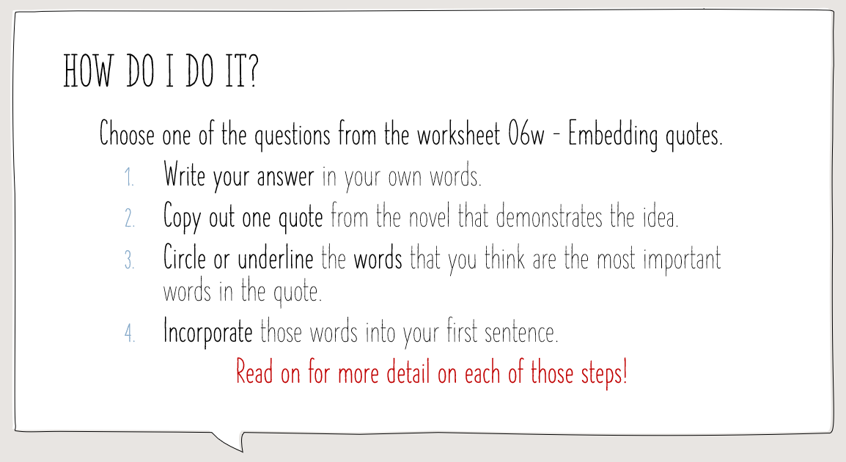
Evidence / Example
The good news is that you learnt how to do this part in the lesson Embedding Quotes:

Slide 27
Evidence / Example
A high-level essay response will contain more than one piece of evidence and explanation.
To push yourself further, try:
Use your embedding skills to include an explanation and evidence in the same sentence.
Use the next sentence to explain and embed a different example of the same idea.
For example, if your paragraph is presenting the claim that imagination can comfort those in difficult times, you could:
Explain how Subhi’s Shakespeare Duck gives him someone to talk to when he is unsure of what to do
Explain how Eli’s Night Whale allows him to connect with his culture when he is alone in the centre

Slide 28
Your Turn
You have two options:
Write your next sentence that embeds evidence to support your explanation.
Re-write the explanation that you just wrote, adding an embedding quote. Then, write a second explanation with embedded evidence.

Slide 29
Linking Sentence
TEEL Paragraphs

Slide 30
Linking Sentence
The purpose of this last sentence is to connect your paragraph to the essay’s main idea.
It should:
reflect on how the examples you have analysed work together to demonstrate your claim
reflect on how this claim contributes to your essay’s contention

Slide 31
Linking Sentence
Just like the other paragraphs, you should think carefully about the subject of your linking sentence.
You might write about a character, the text or an idea.
You should also begin with a linking word - a type of prepositional phrase.

Slide 32
Linking Sentence
Character:
As a result of their harsh life inside the centre, both Subhi and Eli use their imaginations to find comfort in other worlds and ideas.
Consequently, both Nasir and Ma demonstrate the importance of stories in keeping histories alive for the next generation.

Slide 33
Linking Sentence
Idea:
Ultimately, the living conditions depicted by Fraillon appear to be an abuse of Eli and Subhi’s basic human rights.
When considered together, Fraillon’s use of descriptive language and symbolism create a bleak picture of life in detention.

Slide 34
Linking Sentence
Text:
As a result, The Bone Sparrow acts as a criticism of some of those working in Australia’s refugee detention system.
In the end, Zana Fraillon highlights the difference between the way some Australians imagine those who seek asylum and the reality of their lives behind the fence.

Slide 35
Your Turn
Complete the paragraph in your exercise book by writing your link sentence.

Slide 36
Putting it all together
Look at these examples

Slide 37
Example 1 – simple sentences
Topic sentence
Explanation 1
Evidence 1
Explanation 1
Evidence 2
Explanation 2
Linking sentence
Stories and imagination stop people from thinking they have nothing to live for. In chapter 13, Nasir’s pebbles act as a symbol for the memories that remind people of happier times. Nasir teaches Subhi how to use the pebbles, explaining that “Each pebble can only hold one thought” (pg. 89). Subhi uses the pebbles to bring back joyful memories of his Ba who is still imprisoned in Myanmar. In the Bone Sparrow, descriptions of characters’ memories highlight a feeling of depression, where instead of happy thoughts all they can remember are gunshots and “bombs that kept falling from the sky” (pg. 135). This is one of the reasons Nasir’s pebbles are so effective - to remind people that they have a future. Essentially, Imagination can calm people down and create meaning to people lives which helps them cope in severe times.

Slide 38
Example 1 – simple sentences
Topic sentence - idea
Explanation 1 - language
Evidence 1 - character
Explanation 1 - character
Evidence 2 - language
Explanation 2 - idea
Linking sentence - idea
Stories and imagination stop people from thinking they have nothing to live for. In chapter 13, Nasir’s pebbles act as a symbol for the memories that remind people of happier times. Nasir teaches Subhi how to use the pebbles, explaining that “Each pebble can only hold one thought” (pg. 89). Subhi uses the pebbles to bring back joyful memories of his Ba who is still imprisoned in Myanmar. In the Bone Sparrow, descriptions of characters’ memories highlight a feeling of depression, where instead of happy thoughts all they can remember are gunshots and “bombs that kept falling from the sky” (pg. 135). This is one of the reasons Nasir’s pebbles are so effective - to remind people that they have a future. Essentially, imagination can calm people down and create meaning to people lives which helps them cope in severe times.

Slide 39
Example 2 – compound sentences
Topic sentence
Explanation with evidence
Explanation with evidence
Explanation with evidence
Linking sentence
The quality of life inside the detention centre is limited by a lack of resources and luxuries for the characters. Water is in limited supply in the centre, and those living inside only get “half scoops” of food since there have been “food shortages … for days” (p 4). Zana Fraillon describes the living conditions using vivid emotive language to highlight the “flies and worms” in the “brown” and mushy” food that makes their stomachs “churn”. Similarly, even though there are “900 refugees living in the centre, there are only “fourteen pairs of real shoes in [the] whole entire camp,” but Subhi gets a new pair from Eli for helping him with the deliveries to replace his “too-small thongs” (p 24). Therefore, the novel illustrates how qualities of life inside the detention centre are poor and the camp has limited resources..

Slide 40
Example 2 – compound sentences
Topic sentence - idea
Explanations with evidence – idea, character and idea
Explanations with evidence - author
Explanation with evidence – idea, character
Linking sentence – text
The quality of life inside the detention centre is limited by a lack of resources and luxuries for the characters. Water is in limited supply in the centre, and those living inside only get “half scoops” of food since there have been “food shortages … for days” (p 4). Zana Fraillon describes the living conditions using vivid emotive language to highlight the “flies and worms” in the “brown” and mushy” food that makes their stomachs “churn”. Similarly, even though there are “900 refugees living in the centre, there are only “fourteen pairs of real shoes in [the] whole entire camp,” but Subhi gets a new pair from Eli for helping him with the deliveries to replace his “too-small thongs” (p 24). Therefore, the novel illustrates how qualities of life inside the detention centre are poor and the camp has limited resources..

